Slide 1
Heaps
A Tree-Based Data Structure
Programming – Code Design & Data Structures

Slide 2
Contents
What is a Heap?
Common uses for a heap?
Common operations on a heap?
Speed of Operations

Slide 3
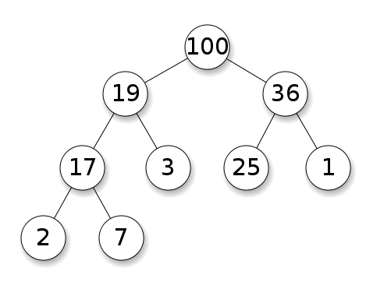
What is a heap?
A tree-based data structure
Two different types:
min-heap: the value of each node is greater than or equal to the value of its parent, with the minimum-value element at the root.
max-heap: the value of each node is less than or equal to the value of its parent, with the maximum-value element at the root.
Often stored in an array
Fixed size or Dynamic
Different types of heaps store information differently in the arrays

Slide 4
The Binary Heap
The most common form of heap follows the following constraints:
No more than two children per node
All levels of the tree, except possibly the last one (deepest) are fully filled, and, if the last level of the tree is not complete, the nodes of that level are filled from left to right
All nodes are greater than or equal to each of its children
In a min-heap, all nodes are less than or equal to each of its children

Slide 5

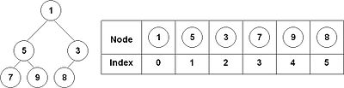
Binary Heap – How are they stored?
Usually stored in an array for efficiency reasons.
Could also be stored in a tree.
First index holds the first node.
Next two hold the children of the first node
Next four hold the children of the second and third nodes.
And so on….
Allows for quickly calculating the location of nodes in the array.

Slide 6

Binary Heap – How are they stored?
When stored in an array, the parent and children of a node can be found at:
Parent:
$floor(\frac{\left(i−1\right)}{2})$
Children:
1st : $2i+1$
2nd: $2i+2$
Where $i$ is the index of the node in the array

Slide 7
Common uses for a heap?
Great for storing data where the smallest (or largest) value needs to be easily accessible.
Examples:
Calculating and storing the costs/benefits of different actions an AI could do.
Can then get the “best” action quickly from the top of the heap.
Proven most efficient implementation of a Priority Queue

Slide 8
Common operations on a Heap:
Add/Insert/Push
Adds a new value to the heap
Requires the heap to be “rebalanced”
Remove
Removes a value from the heap
Requires the heap to be “rebalanced”
Peek
Get the value of the root element of the tree
Either the lowest or highest value, depending on how the tree is sorted
Pop
Remove the root element from the tree
Either the lowest or highest value, depending on how the tree is sorted

Slide 9
Common operations on a Heap:
Find
Searches the tree for a specific value. If an object is associated with the value, returns the object
Size
Returns the number of values stored in the tree
Iterators/Step functions
Some way in order to step through every value in correct order, and perform operations
Clear
Removes all values from the heap

Slide 10
Implementing the Push Function
Uses the “up-heap” operation
Three steps required:
Add the value to the bottom of the tree
Swap the value with its parent if the parent is smaller than the value (or larger, for a min-heap)
Repeat until no more swaps are required!

Slide 11
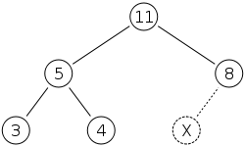
Implementing the Push Function
Adding 15 to the tree

Slide 12
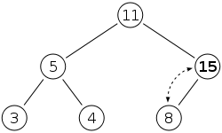
Implementing the Push Function

Slide 13
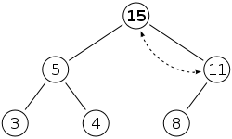
Implementing the Push Function

Slide 14
Implementing the Remove/Pop Function
Uses the “down-heap” operation
Three steps required:
Replace the value to be removed with the last value stored in the tree
Swap the new value with its child if the parent is larger than the new value (or smaller, for a min-heap)
Pick whichever child is larger
Repeat until no more swaps are required!

Slide 15
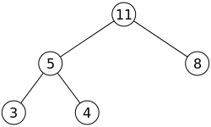
Implementing the Remove/Pop Function
Calling Pop to remove the 11

Slide 16
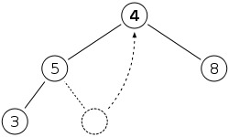
Implementing the Remove/Pop Function

Slide 17
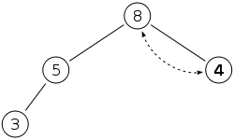
Implementing the Remove/Pop Function

Slide 18
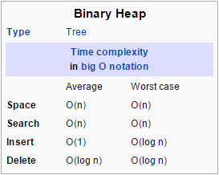
Speed of Common Operations
Fast to find the smallest/largest value
O(1)
Slow for searching, O(n)
Quite good times for insert/delete
Optimal data structure for a priority queue

Slide 19
Summary
There are many different types of Heaps
Binary heaps are common, but not the only type
Heaps are a great way to store data if you only need it partially ordered
They can be complex to set up, due to how information is stored

Slide 20
References
Allen Sherrod, 2007. Data Structures and Algorithms for Game Developers (Charles River Media Game Development). 1 Edition. Charles River Media.
Thomas H. Cormen, 2001. Introduction to Algorithms, Second Edition. 2nd Edition. The MIT Press.

